Slide 1

Ferris Hockey Intelligence
Insights Beyond the Scoresheet
Zach Ferris
Founder
zach@ferrishockeyintelligence.com
(705)-709-1621
FerrisHockeyIntelligence.com

Slide 2
Background
10+ years of coaching experience
Graduate of Durham College's 3-year Sport Management program
Experience across various levels ranging from house league to AAA Rep and Junior hockey
Various positions include Head Coach, Assistant Coach, Video Coach, Player Development & Recruitment Lead, Advanced Scouting Coordinator, Etc.

Slide 3
Problem
🧊 Limited ice time
🗣️ Players forget verbal instruction
👀 Coaches can't watch every player every shift
📊 Players want measurable development
⏳ Practice time is too valuable to waste explaining previous games

Slide 4
Solution
Ferris Hockey Intelligence Provides;
  📹 Professional game filming
  📺 Team video breakdowns
  👤 Individual player analysis
  📝 Teaching clips
  🤝 Coach support throughout the season

Slide 5
Why Video Works
Athletes retain visual instruction significantly better than verbal instruction alone
NHL, NCAA, OHL, and other junior teams all rely heavily on video
Visual learning speeds decision making
Instead of saying: "you were out of position"
Show them
Improve teaching and understanding immediately

Slide 6
Benefits
Coaches | Players | Parents
Save Practice Time | Faster Development | See Development
Better Teaching | Better Hockey IQ | Added Value
Easier Communication | Increased Confidence | Transparency
Objective Feedback | Learn from Real Situations

Slide 7
Why Choose FHI?
🎥 Hockey-Specific Filming
Trained hockey videographers
Consistent, high-quality footage designed for teaching and analysis
🧠 Coaching Through Video
Team systems breakdowns
Individual player analysis
Position-specific feedback
⏱ Fast & Reliable
Quick turnaround on game footage and video breakdowns
Ongoing support throughout the season
🤝 Personalized Service
Flexible packages for teams, organizations, and individual players
Local, responsive, and committed to your program's success

Slide 8
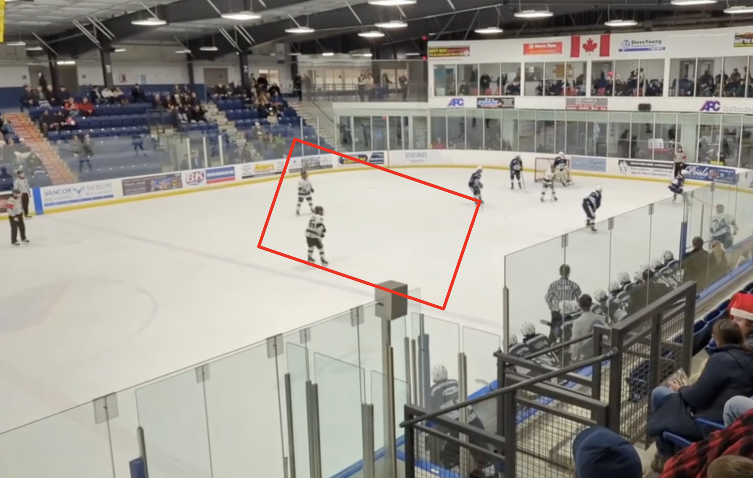
Examples
Paris Titans (Jr. C) Pre-Scout of Woodstock Navy Vets
Paris Titans Playoff Review vs Woodstock Navy Vets
Looked to capitalize on the available space in the prime scoring area created by their penalty kill coverage

Slide 9
Organization Testimonials
"Video coaching helped my child grow in both skill and confidence through clear, positive, and actionable feedback. I highly recommend Ferris Hockey Intelligence to any family focused on player development."
  Calla D, Hockey Parent
"Ferris Hockey Intelligence has elevated our program by improving player development, hockey IQ, and coaching efficiency. The visual feedback has maximized our practice time and provided a real competitive advantage."
  Derek B, Hockey Executive Member & Coach
"FHI's organized video breakdowns and opponent scouting improved our game preparation and helped us maximize every minute of practice. It became an essential part of our coaching process."
  Dave S, Hockey Executive Member & Coach

Slide 10
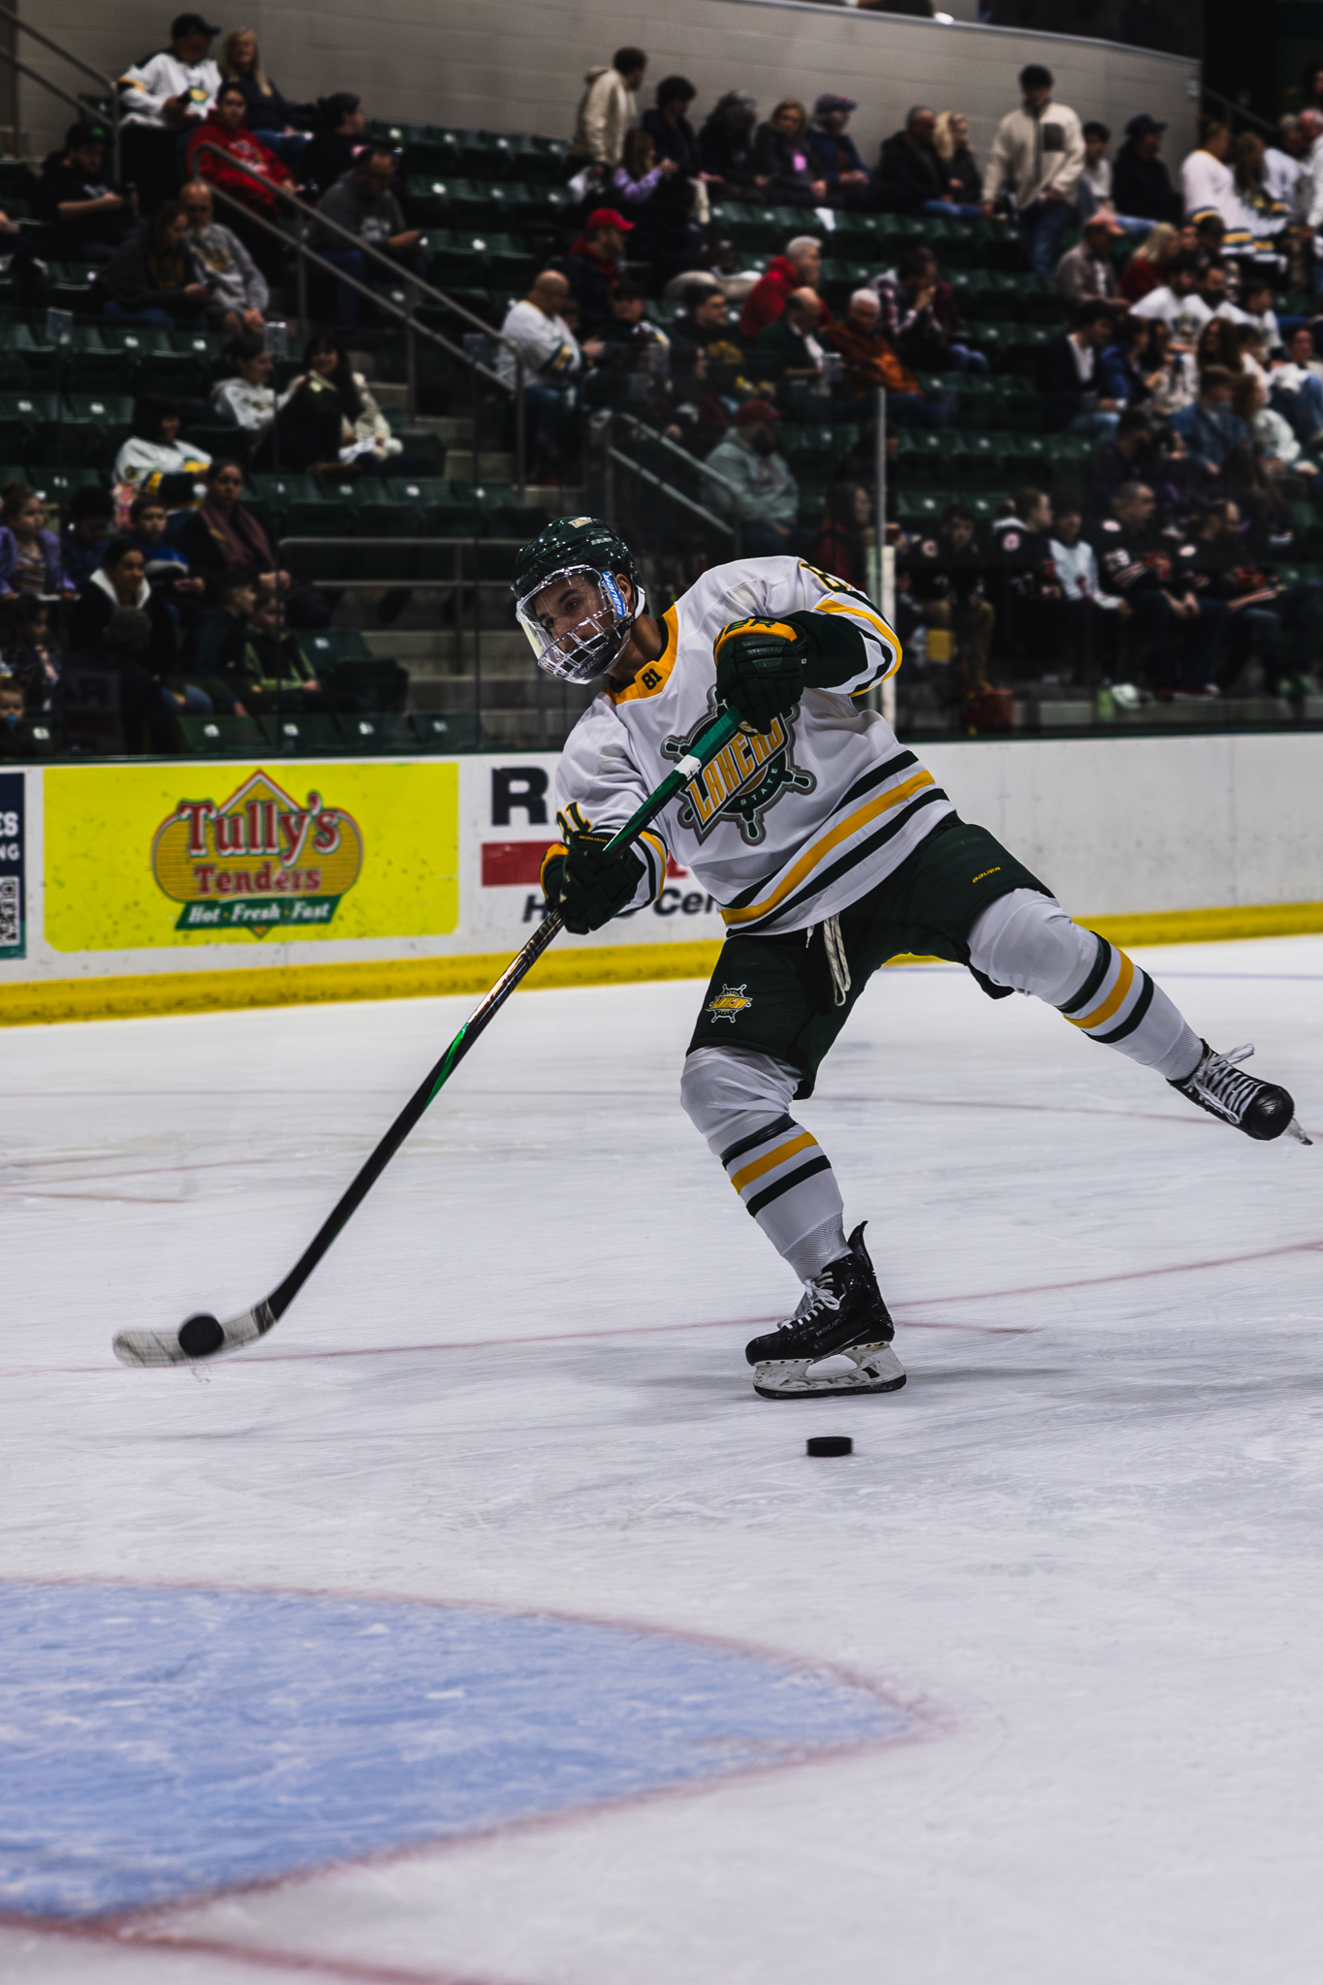
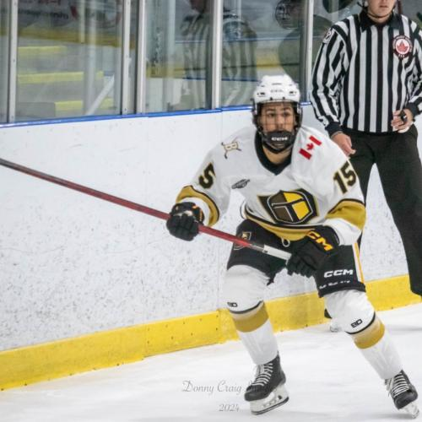
Player Testimonials
"The highlight reel was professional and showcased my game exactly how I envisioned it, making the recruiting process much easier. Video coaching also improved my hockey IQ by helping me recognize and correct key decisions before my next game."
  Nico P, NCAA III Player
"The personalized video breakdowns helped me recognize opportunities before they developed, creating more offensive chances. Zach's fast turnaround and detailed coaching make his service invaluable for player development."
  Simon O, Jr. B Player

Slide 11
Ready to Elevate your Development?
Partner with Ferris Hockey Intelligence for:
  🏒 Team Video Partnerships
  🎥 Individual Player Analysis
  📈 Organization-Wide Video Coaching Solutions
Let's Start the Conversation!
  📧 info@ferrishockeyintelligence.com
  📱 (705)-709-1621 (call or text)
  🌐 FerrisHockeyIntelligence.com
  📲 Instagram and Facebook: @FerrisHockeyIntelligence
Ferris Hockey Intelligence
  Insights Beyond the Scoresheet

